Slide 1
UNCLASSIFIED
SPECIAL OPERATIONS FORCES INDUSTRY CONFERENCE
Win Transform People
Ms. Lisa Sanders Director, Science & Technology
SCIENCE & TECHNOLOGY Engagements and Opportunities

Slide 2
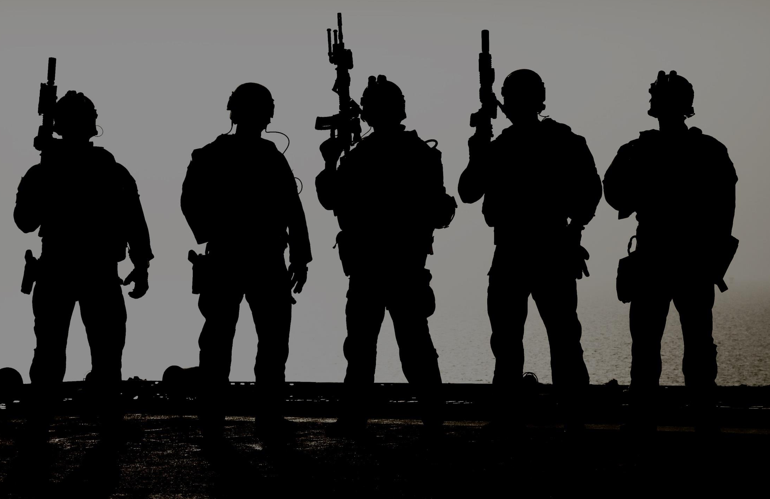
SOF AT&L-ST Vision
Discover, Enable, and Transition technologies
to provide an asymmetric advantage for
Special Operations Forces
2

Slide 3
Science & Technology Budget
Copy
Applied Research (BA2) & Advanced Technology Development (BA3)
BA2: Studies, Early Laboratory Hardware, Software Development Models, Concept Exploration. Technology Readiness Level (TRL) 3-5
BA3: Operational Prototypes, Advanced Technology Demonstrations, Technical Experimentation, Technology Insertions. TRL 5-7
ACQUISITION STRATEGY
PERIOD OF PERFORMANCE
MILESTONES
Various (Competition, IDIQ, CRADA, Prize Challenges, etc.)
External Leveraging (OGAs, Services, Laboratories)
Project Dependent
Emphasizing Tech Discovery, PEO TIRs needs, and game-changing technology development
Project Dependent
POINT OF CONTACT
FUNDING
CURRENT CONTRACT/OEM
USSOCOM SOF AT&L, Technology & Industry Liaison Office (TILO) (813) 826-9482
FY18 BA2/BA3: $19.05M/$71.62M = $90.67M
FY19 BA2/BA3: $20.36M/$51.58M = $71.94M
Note: Does not include TTL / MISO
Various

Slide 4
S&T Portfolio Challenge
ADVERSARY
Advantage, accessibility, speed, freedom from constraints
INDUSTRY
SOF AT&L
PEO
IR&D, Product Development, Engagement
Acquisition Executive, Deputy Acquisition Executive, Comptroller
PEO vision, People, Programs, Tech Insertions, Tech Development, Resources
FUTURES
Vision, analysis, planning, resourcing, transitions
INNOVATION
OSD
SOCOM
S&T, SOFWERX Ecosystem, OTAs, Rapid Prototyping, Crowdsourcing, Venture Capitalists, Experimentation, Grants, CRADA’s, Capstone, Hacking 4 Defense, Social Media
QDR, Acquisition Reform, ASD Policy, ASD R&E, ASD SOLIC, ASD O, Presidential Directives, Congress …
Commander Guidance, Assessment Director, S&T Director Futures Guidance, Component Gaps, TSOC Gaps

Slide 5
S&T Portfolio Analysis
Signature Management
Human-Machine Interaction
Protection
EXPLORING
Big Data
Optics / Sensors
Artificial Intelligence
Human Performance
Technology Development
Working Group (TDWG) Leads
Cohesive understanding of respective Near-, Mid- and Far-Term technology areas
Create, facilitate and maintain working relationships with users, tech developers, transition partners, co-development partners (Labs, Services, etc..)
Use efficient communication methodologies to convey information and ensure transparency
Develop expertise
Cost, Schedule and Performance
Force Application
CUAS
Cyber / Analytics
Mobility
Biomedical
MONITORING
Power & Energy
TDWGs
Advanced Communications
Directed Energy
CWMD (PM-CP, DTRA, J5)
COLLABORATING
Continual Evaluation of Priorities
Status
Monitoring

Slide 6
UNCLASSIFIED
UNCLASSIFIED
S&T Futures Process
1

Results
2
MATERIEL
APPROACHES
Leap Ahead
Asymmetric
Divergent
NON-MATERIEL
Policy, Authority
& Doctrine
Assess & Describe
Impact/Opportunity
NEW PROBLEM
IDENTIFICATION
Opportunity
Threat
Follow-on
Analysis
Results
3

Rapidly Changing Technology
CONSIDERATION
4

Changing Environments
CONSIDERATION
3

Varying Mission Objective
(Measures of Success)
CONSIDERATION
2
CONSIDERATION
1

Changing Strategic Conditions
Designed by PresentationGo.com
6
UNCLASSIFIED

Slide 7
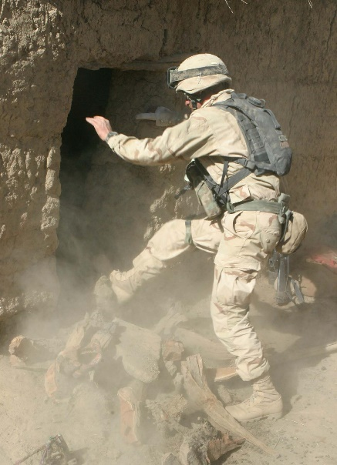
SOF Hard Problems
United States Special Operations Command’s Science and Technology (S&T) Directorate has developed three Special Operations Forces (SOF) Hard Problems that are of critical importance to SOF missions. They are: Small Unit Dominance, Mission Assured Communications, and Signature Management. The three SOF Hard Problems are available for download at: https://www.socom.mil/SOF-ATL/Pages/SOF-Hard-Problems.aspx.
If you think you've got a solution that can help USSOCOM’s S&T Directorate solve some or all of the SOF Hard Problems please reply via their Hard Problems mailbox also located on that same website. Please feel free to distribute this information to interested parties that could provide potential solutions to these S&T SOF “Hard Problems.”

Slide 8
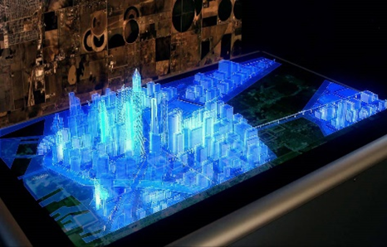
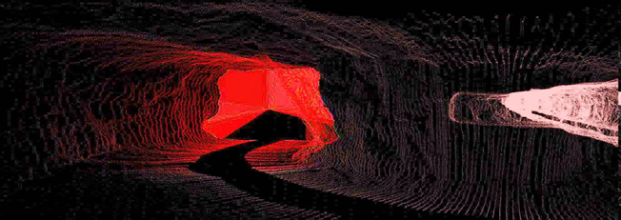
S&T Main Focus Areas
Tactically Relevant Situational Awareness
Next Generation Identification and Characterization - comprehensive and verifiable location of targets across various sensor systems
Applicable in all environments – not just airborne assets in uncontested environments
Includes means to turn information into decision quality data – Artificial Intelligence (AI)/Machine Learning (ML)
Includes human-machine interface to make the data accessible and usable to all SOF echelons – operator through Tactical Operations Center (TOC) Commander
Communication and Navigation in all Environments
Global Positioning System (GPS) Denied – regardless of cause
Hostile, contested, and Crowded Electromagnetic Spectrum
Low Signature
Tailored Lethality
Counter-materiel & Counter-personnel
Incorporates scalability and reversibility
Biotechnologies
Understand and counter adversary Weapons of Mass Destruction (WMD)/terror/effect
Explore means to optimize SOF warfighter capability/performance throughout their career

Slide 9
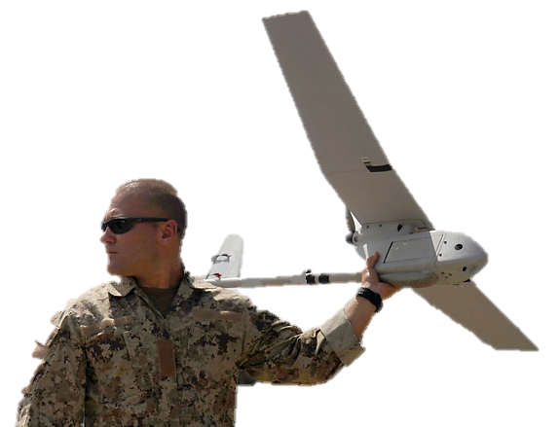
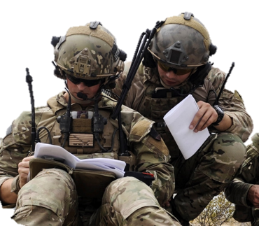
Hyper Enabled Operator
TECHNOLOGY PILLARS
COMMUNICATIONS
COMPUTING
DATA / SENSORS
HUMAN- MACHINE INTERFACE
From Reactive to Predictive, in Front of the OODA Loop

Slide 10
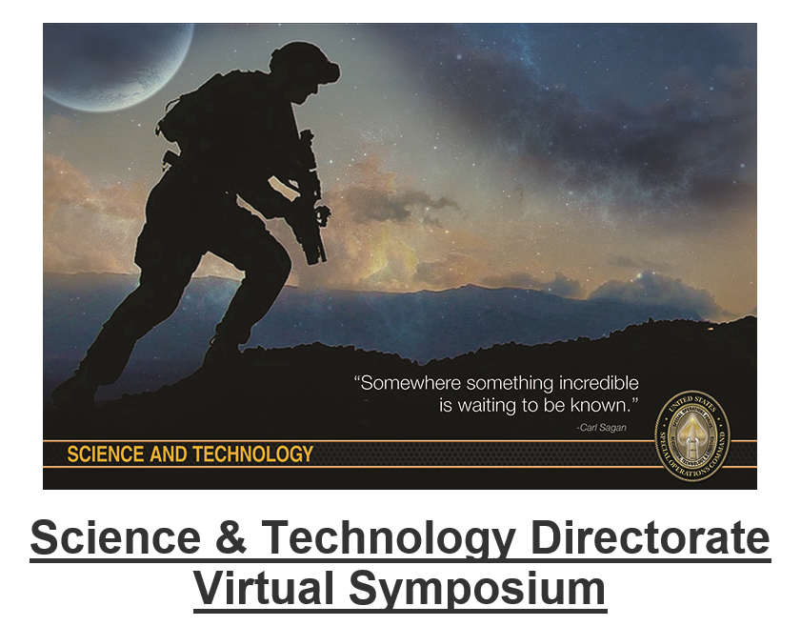
FY19 S&T Virtual Symposium
Future Operating Environment
SOF Challenge Areas:
Next Generation Identification and Characterization
Contested Environment Situational Awareness
Countering Autonomous Systems
Strategic and Tactical Signature Management
Tactical Communication and Navigation
Tactical Remote/Autonomous Systems and Human Machine Interface
REGISTER AT: https://www.socom.mil/SOF-ATL/Pages/TDWG-Virt-Symp.aspx

Slide 11
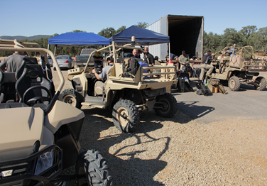
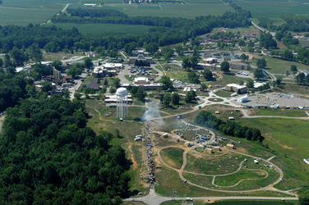
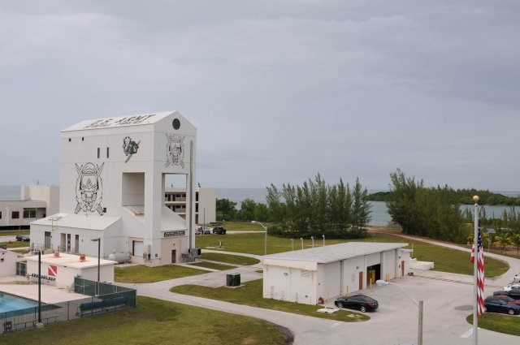
Technical Experimentation (TE)
TE 18-3, 17-21 July 2018 at Fort A.P. Hill, VA
Experimentation Focus: C4, Cyber, ISR, Mobility, and Small Unmanned Aerial Systems (SUAS)
TE 19-1, 5-9 November 2018 at Avon Park Air Force Range, FL
Experimentation Focus: Hyper Enabled Operator
Public Link:
https://www.socom.mil/SOF-ATL/Pages/technical-experimentation.aspx
Linked Group: SOCOM Technical Experimentation
11

Slide 12
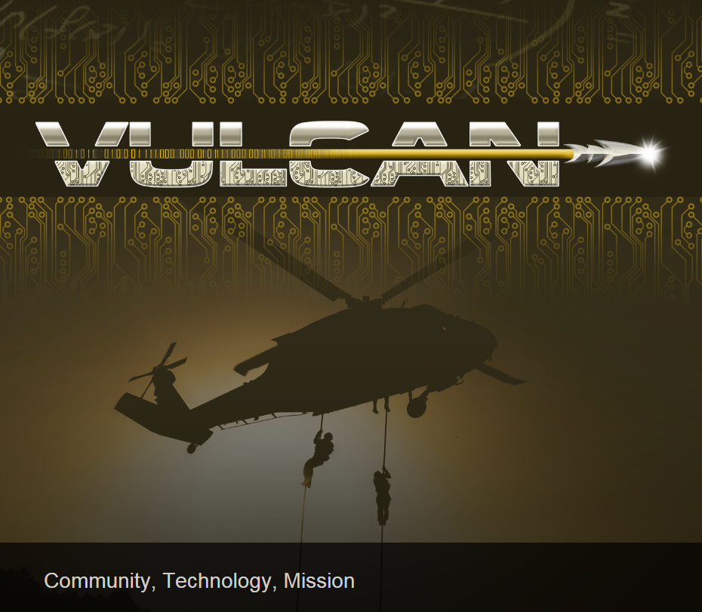
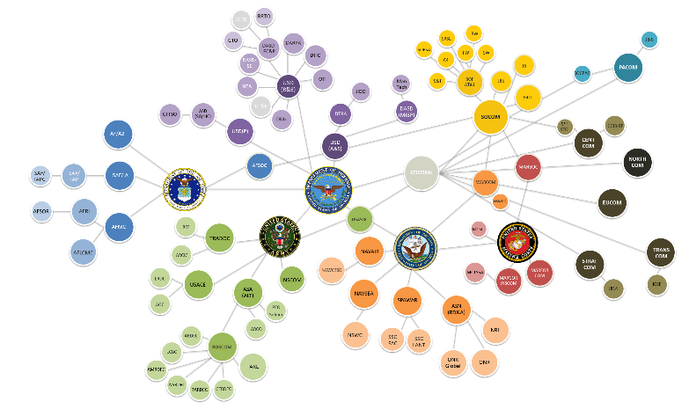
Vulcan-Technology Scouting Application
Web-based platform that enables anyone to quickly describe technology and upload supporting documentation to a secure, shared, searchable, central database
Information is entered into a “Scout Card”
Scout Cards can be easily disseminated across the SOF Enterprise to individuals or teams
Enables everyone in SOF to be a Tech Scout
Government users can remotely “poke” the organization or individual who originally entered the data to provide updates/respond to comments
Vulcan supports evaluation/assessment/scoring of submitted technologies, and sharing of results
Each time a Scout Card is interacted with it has an associated timeline showing technology maturation across events
Go to https://www.vulcan-sof.com and register
Vulcan provides an exponential increase in efficiency and effectiveness over existing business processes for gathering, disseminating, searching, assessing and acting on technology related information.
12

Slide 13
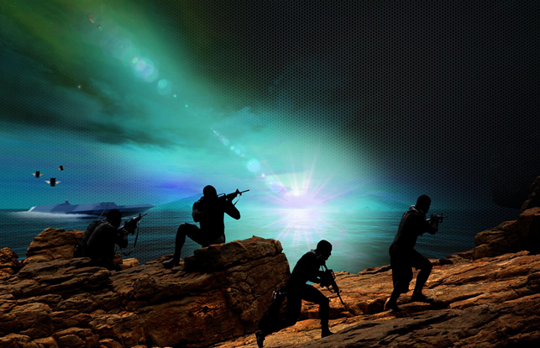
USSOCOM CRADAs
OVERARCHING CRADA
Formulated to provide general access to USSOCOM gaps/needs to foster collaboration – must be consistent with missions of organization
Allows for the formulation and execution of Individual Work Plans (IWP) between the Collaborator – PEO/Directorate within SOF AT&L
Collaborator may request meetings with appropriate personnel to discuss IWP development – through the SOF AT&L Technical POC
SOF AT&L Acquisition Executive signed – company coordination and acceptance – generally 30 days
SPECIFIC (TRADITIONAL) CRADA
Formulated to provide a collaboration on a specific technology
Follows USSOCOM Directive 70-1 Appendix Q procedures
Standard Template
Specifically between collaborator and single PEO/Directorate
Writing and staffing is generally 90 to 120 days
13

Slide 14
S&T Engagement Tools
S&T ACTIVITY | OPPORTUNITY | ENGAGEMENT
SOF Futures Foundry Events POC: Shawn Martin 813-825-4578, shawn.martin@socom.mil | S&T has developed an S&T Futures Process S&T conducts “Futures Foundry” events to enable SOF’s ability to accomplish their missions 10-15 years in the future | S&T plans to conduct 1-2 SOF Futures Foundry Events per Fiscal Year Innovation Foundry events will provide opportunities for attending and injecting disruptive technology solutions for SOF
Small Business Innovation Research (SBIR)/ Small Business Technology Transfer (STTR) POC: Mr. Anthony Aldrich 813-826-9150, anthony.aldrich@socom.mil | S&T manages SOCOM’s SBIR/STTR programs Stimulates innovation for small businesses 3 Phases, Phase I is a Study ($150K), Phase II Prototype ($1.5M), Phase III Commercialization | https://www.socom.mil/SOF-ATL/Pages/sbir.aspx USSOCOM participates in three SBIR/STTR Topics Call per year (April, August, and December timeframes)
Technical Experimentation (TE) Events POC: Mr. Dan Bernard 813-826-9917, dan.bernard@socom.mil | Conducts 3 US-based events every fiscal year each with different theme(s) Industry opportunity to engage and demonstrate technology/concepts and get direct feedback from SOF Operators/Acquisition Professionals | Normally 1 TE Event/QTR, TE Request for Information (RFI) posted on FBO.gov for each TE Event Go to https://www.socom.mil/SOF-ATL/Pages/technical-experimentation.aspx
Cooperative Research & Development Agreements (CRADA) POC: Mr. Howard Strahan 813-826-1267, howard.strahan@socom.mil | SOCOM employs Overarching and Specific (Traditional) CRADAs Legal agreement to provide general and specific access to USSOCOM needs | Allows for the formulation and execution of Individual Work Plans (IWP) between the Collaborator – PEO/Directorate within SOF AT&L
Broad Agency Announcements (BAA) POC: Mrs. Damian Guinn 813-826-7416, damian.guinn@socom.mil | SOCOM S&T Directorate/PEOs develop and post BAAs to FBO.gov that provide Areas of Interest (AOI) to Industry and other External Organizations | S&T BAA once per year in April TALOS BAA once per year in January Biomedical BAA once per year in February through US Army
Vulcan POC: Mr. Howard Strahan 813-826-1267, howard.strahan@socom.mil | Web-based platform that enables anyone to quickly describe technology and upload supporting documentation to a secure, shared, searchable, central database | Vulcan supports evaluation/ assessment/scoring of submitted technologies, and sharing of results Go to https://www.vulcan-sof.com and register
Technology & Industry Liaison Office (TILO) POC: Mrs. Shelvin Watts 813-826-1269, shelvin.watts@socom.mil | Conduit for the SOF AT&L Enterprise Matches your company’s product/service/capability to the appropriate personnel within the command and schedules discussions or demos | Go to https://www.socom.mil/SOF-ATL/Pages/submit-your-idea.aspx for information and link to USSOCOM Areas of Interest and for the TILO Submitting Your Idea Form
14

Slide 15
QUESTIONS?

